Slide 1

DLA hardware
Yi Li
2017/12/14

Slide 2
Outline
Technical topic
Discussion

Slide 3
Technical topic
Technical topic
1)compress/decompress/data format
2)tile/padding
3)input channel partition
4)skip zero
5)pooling/lrn memory mechanism
6)DMA implement
7)Image input
8)software control
9)CNN layer type
10)generator

Slide 4

Technical topic
1)compress/decompress/data format
bit | expand bit | date num per axi | max decompress num per axi
16 | 3/4/5 | 6/6/6 | 384 Bytes
8 | 3/4/5 | 11/10/9 | 288Bytes
4 | 3/4/5 | 18/16/14 | 224Bytes
2 | 3/4/5 | 25/21/18 | 144Bytes
1 | 3/4/5 | 32/25/21 | 84Bytes

Slide 5
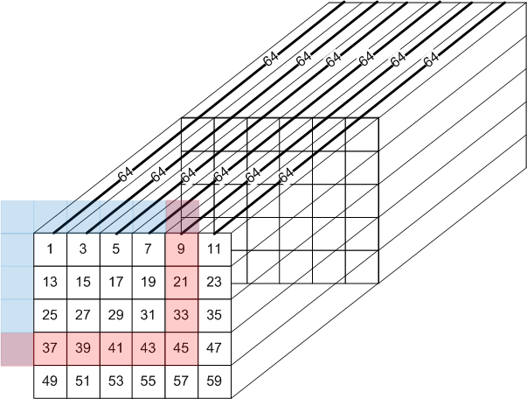
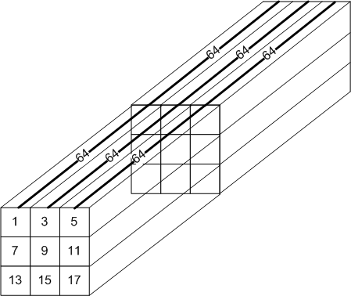
Technical topic
2)tile/padding
very very very wide
How to divide tiles better？
Choose which block add padding better?

Slide 6
Technical topic
2)tile
principle | reason
all input channel | if not all input channel, we should add temp register to preserve temp accumulation value
at least one kernel for all input channel | If not meet one kernel for input channel, we should also add temp register to preserve temp accumulation value

Slide 7
Technical topic
2)tile
Need all input channels

Slide 8
Technical topic
2)tile
Need at least one kernel

Slide 9
Technical topic
2)tile
Feature_{min} = input_channel * kernel_x * kernel_y
Weight_{min} = input_channel * kernel_x * kernel_y
General tile partition strategy,
(Total- Feature_{all})/2 = Weight
input_channel * kernel_x * kernel_y * output_channel(int x16) = Weight

Slide 10
Technical topic
2)padding
padding | drawback | advantage
CDMA | CBUF space wasting | Regular data format on DDR
CSC |  | Regular data format on DDR
BDMA | Being aware of next layer tile partition

Slide 11
Technical topic
2)padding
block | function
CDMA | Transfer boundary data from DDR to CBUF
CSC | compute conv with adding padding

Slide 12
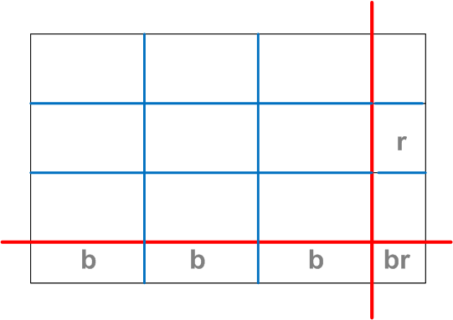
Technical topic
2)padding
From parameters, CDMA and CSC knows how to transfer data and add padding

Slide 13
Technical topic
3)input channel partition
case | Input channel | Output channel | Kernel size_x | Kernel Size_y | Feature Size_x | Feature Size_y
Alexnet conv5 5x5 | 192 | 256 | 3 | 3 | 13 | 13
16
9
1
27
27
16
25
weight
data
clk

Slide 14
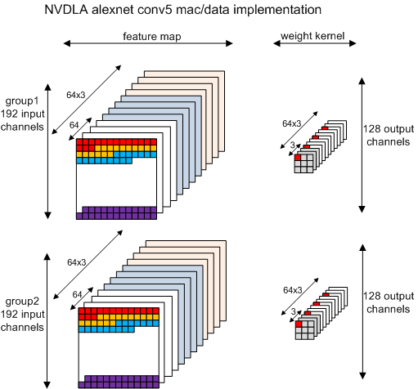
Technical topic
3)input channel partition

Slide 15
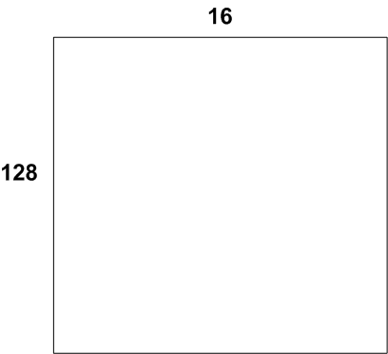
Technical topic
3)input channel partition
input channel | output channel | kernel_x | kernel_y | feature_x | feature_y
160 | 64 | 3 | 3 | 13 | 13
4
9
1
18
18
16
25
weight
data
clk
Total time: （9*18*16 + 1*18*25) * 4 = 12168
Utilization: 62.5%

Slide 16
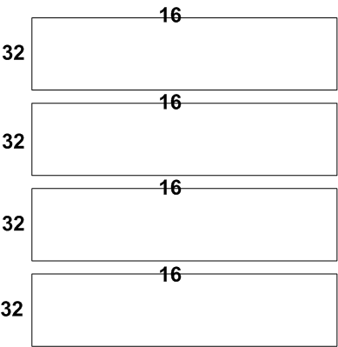
Technical topic
3)input channel partition
input channel | output channel | kernel_x | kernel_y | feature_x | feature_y
160 | 64 | 3 | 3 | 13 | 13
1
9
1
45
45
16
25
weight
data
clk
Total time: （9*45*16 + 1*45*25) * 1 = 7605
Utilization: 100%

Slide 17
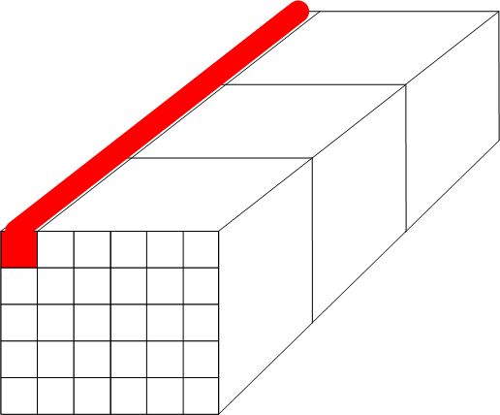
Technical topic
3)input channel partition
input channel | output channel | kernel_x | kernel_y | feature_x | feature_y
160 | 64 | 3 | 3 | 13 | 13
3
…
2
5
1
3
4
2
1
Require sub mem read

Slide 18
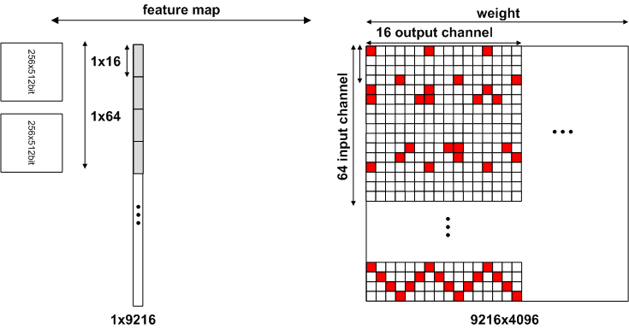
Technical topic
4) skip zero
How to skip zero value computing efficiently?

Slide 19
Technical topic
4) skip zero
Add 4bit/2bit in each mem for indicating next non-zero value

Slide 20
Technical topic
4) skip zero
Divide mem into small width

Slide 21
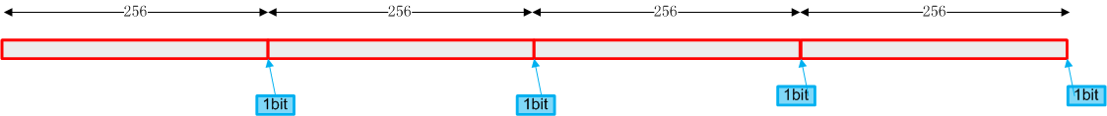
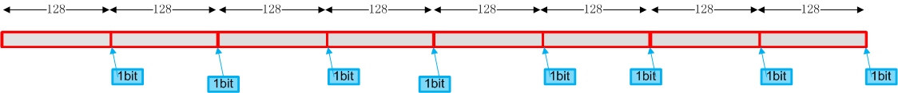
Technical topic
4) skip zero
2 conditions :
Distributed accumulation
Distributed mem
The less Feature num, the more efficiency in each cycle
costs :
Add extra bits on memory
Add extra interface between CSC and CBUF for indicating current computing index (4bit-6bit per computing engine)

Slide 22
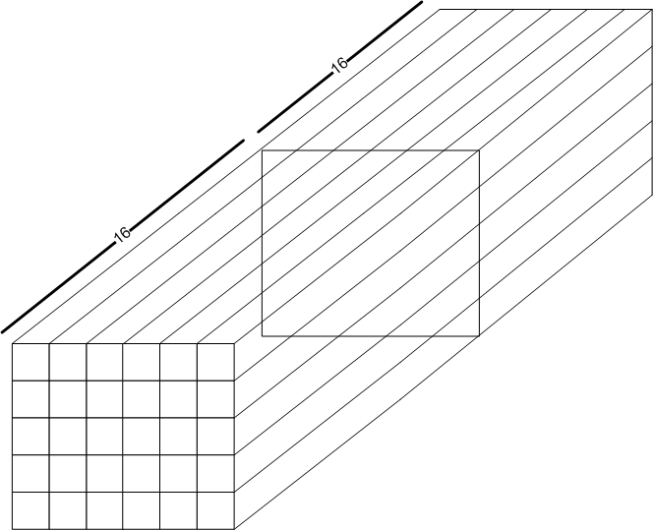
Technical topic
5)pooling/lrn memory mechanism
After convolution, feature computing order

Slide 23
Technical topic
5)pooling/lrn memory mechanism
pooling:
1)need add padding, stride
2)Min buffer size require: pool_size_y*output_feature_x*16

Slide 24
Technical topic
5)pooling/lrn memory mechanism
lrn:
1)need add padding, stride
2)Min buffer size require:
depth*output_feature_x*output_feature_y

Slide 25
Technical topic
6)DMA implement
BLOCK | FUNCTION | object
CDMA | 1) send read request to DDR 2) add extra bit for skipping zero | Decompress -> ->CSC
BDMA | send write request to DDR send write request to CBUF adjust data format | CMAC/SDP/PDP/CDP/RUBIK -> ->compress
How to
1) Memory consistency for master/slave AXI

Slide 26
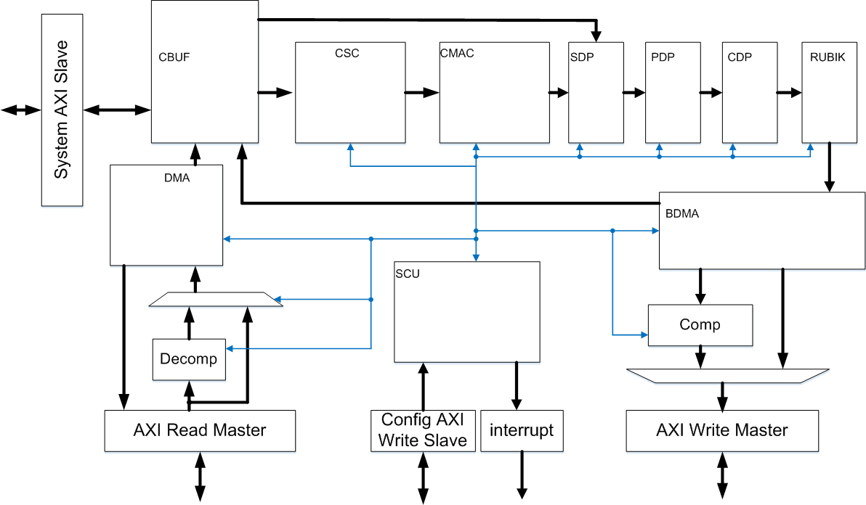
Discussion
1.Different bits
2.Run-length coding
3.Buffer/Queue

Slide 27
Discussion
1.Send read request to DDR(tile boundary data)
2. Write CBUF
3. Compute skip zero distance

Slide 28
Discussion
1.Distributed memory
2.Extra bits for skipping zero value

Slide 29
Discussion
1.Adding padding
2.Control data sequence for CMAC
3.Skip zero and send signal for CMAC (Add extra interface)
4.Weight Index mode

Slide 30
Discussion
1.CMAC computing
2.Input channel partitioning

Slide 31
Discussion
1. Can reload data from CBUF directly

Slide 32
Discussion
Adjust data format
Transfer data to CBUF
Transfer data to DDR

Slide 33
Discussion
Compress feature data

Slide 34
Discussion
Store input configure (more than 3 group buffer for supporting 3 layers. TBD)
Control others blocks and process interrupt

Slide 35
Discussion
10) Image input
Only 3 input channel, if 8bits pixel, (total 1024bit, 256bit each engine), utilization only 10%
Data format in DDR. Which block is in charge of data reorder. (DMA?)
7)software control
Distributed register set
Centralized register set
8)CNN layer type
All mainstream, Alexnet/googlenet/resnet
FCN/segnet/mask RCNN
YOLO/SSD/faster-rcnn
9)Generator
Network parser/Instruction/data transfer

Slide 36
Discussion
SPEC
verification
C-model
rtl
algorithm
implementation

Slide 37
THANKS ! Q & A

